Slide 1
Pharma literature assistant – value chain automation
Gen AI-Powered Automation of Scientific Literature Review, Sub-Question Planning & Insight Extraction
Technology: Graph-Based RAG + Gen AI Agents
Industry: Pharmaceuticals & Life Sciences
Business Function: R&D, Medical Writing, Regulatory Surveillance
BACKGROUND
APPROACH
BENEFITS
Manual, slow review of biomedical papers and regulatory guidelines.
High risk of missing critical clinical, safety, or regulatory updates.
Repetitive research and summarization tasks for medical writers.
Lack of a centralized tool for generating accurate, evidence-backed insights.
Difficulty in handling vague or broad queries from stakeholders.
Graph-Based RAG Workflow powers structured, plan-first answering of scientific queries.
Multi-Agent System handles:
Planning Agent: Breaks down complex queries into structured sub-questions.
Search Agents: Perform targeted RAG over internal (PDFs) and external (PubMed, Springer) databases.
Summarization Agent: Synthesizes evidence into detailed or simplified formats, adaptable to user roles.
Human-in-the-Loop Agent: Captures expert edits and integrates feedback at each stage.
Supports Section-by-Section Execution using a Search–Reflect–Write loop.
70–80% reduction in manual effort for research review & summarization.
Faster delivery of decision-ready, evidence-based reports.
Centralized insights for Regulatory Surveillance, Ingredient Risk Watch & Consumer Trends.
Enables to track ESG, flag regulatory risks & extract competitive intelligence.

Slide 2







Intelligent pharma literature tool flow diagram
Research Planner
Literature Search Specialist
Scientific Content Synthesizer
QA Analyst
Domain Expert
Searches PubMed, PDFs, etc., using keywords and filters to find relevant research papers
Ensures accuracy, removes inconsistencies, strengthens weak reasoning or contradictory claims
Validates the plan, output tone, scientific integrity, and fitness-for-purpose
Defines the report structure and breaks down the topic into logical sections and sub-questions
Reads papers, extracts insights, writes evidence-backed narrative content
Planner Agent
Retriever Agents
Reflection Agent
Human-in-the-Loop Checkpoints
Synthesizer Agent

Slide 3
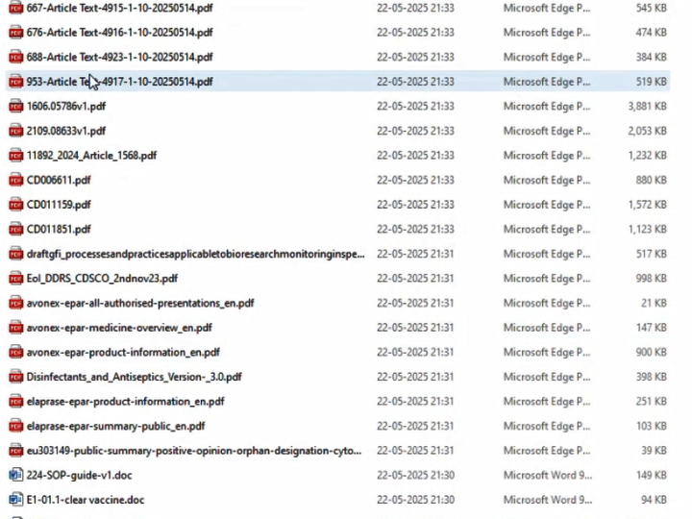
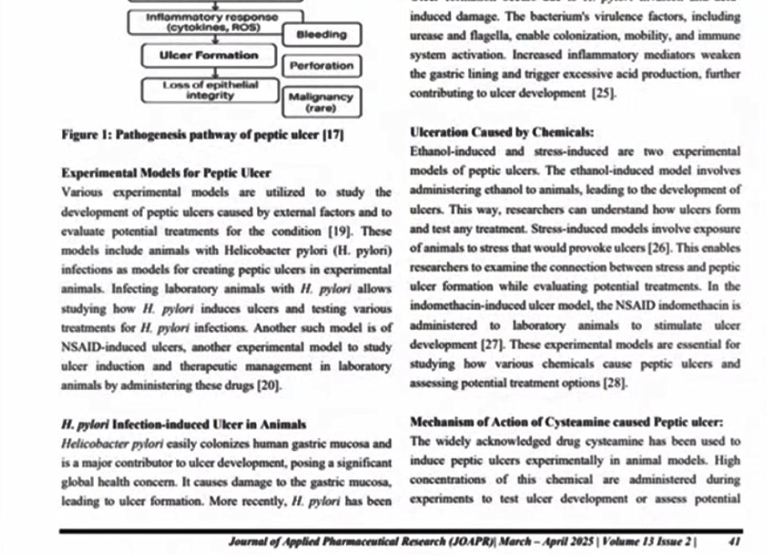
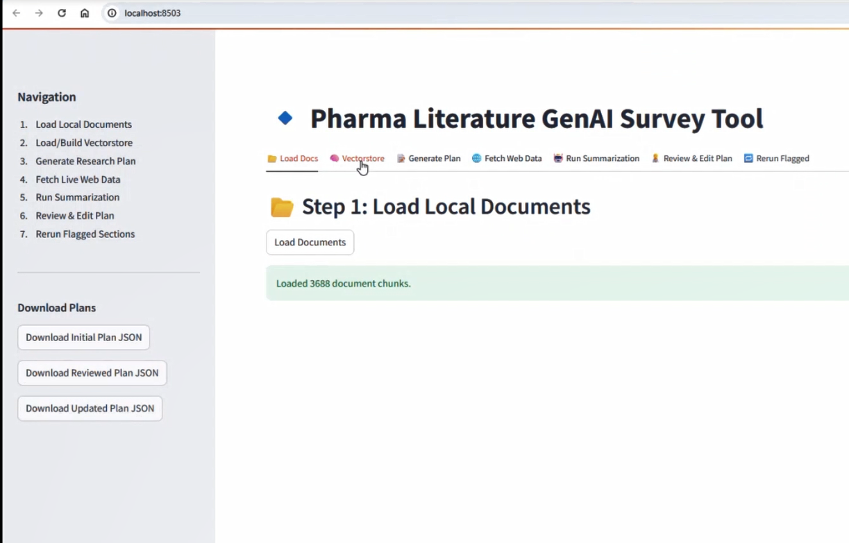
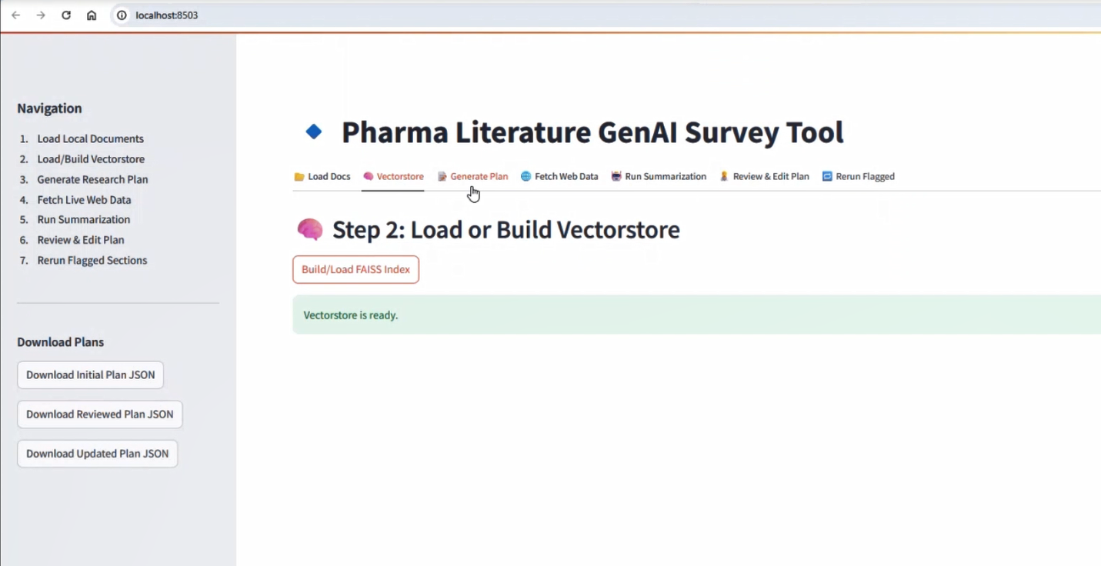
Screens Snippets

Slide 4
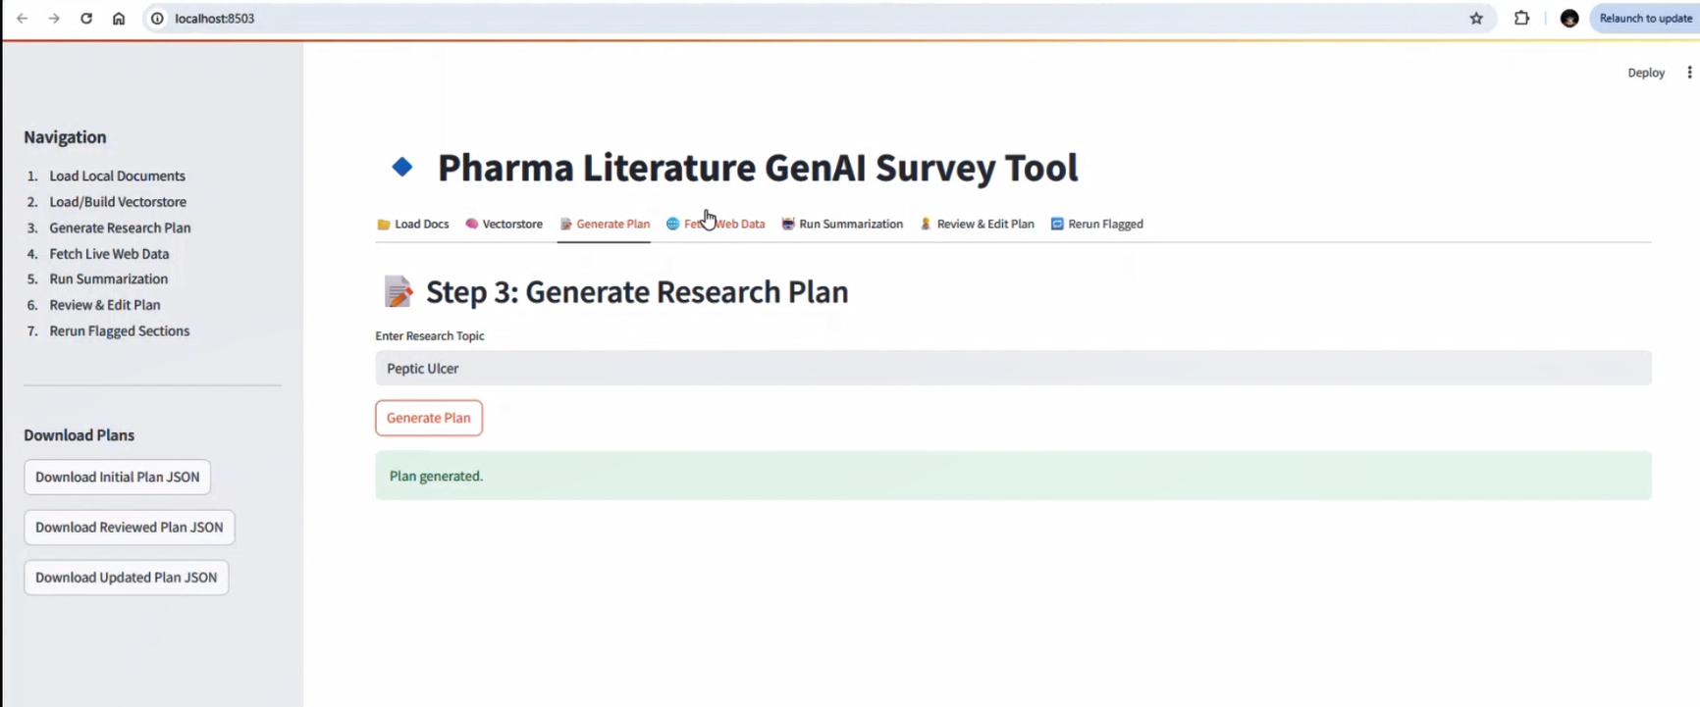
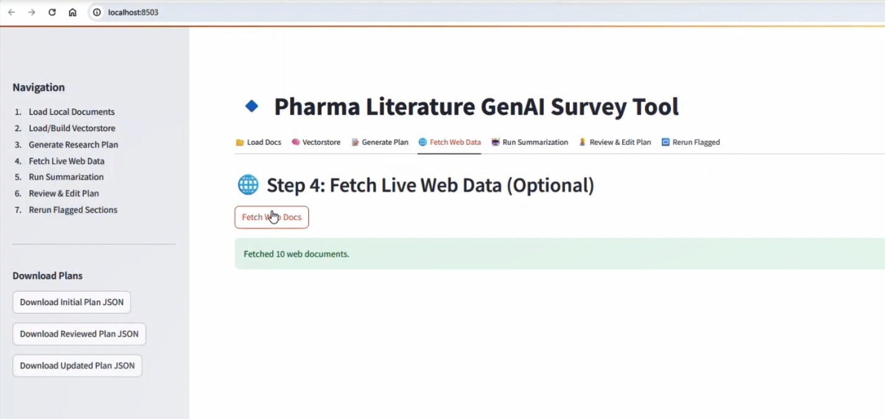
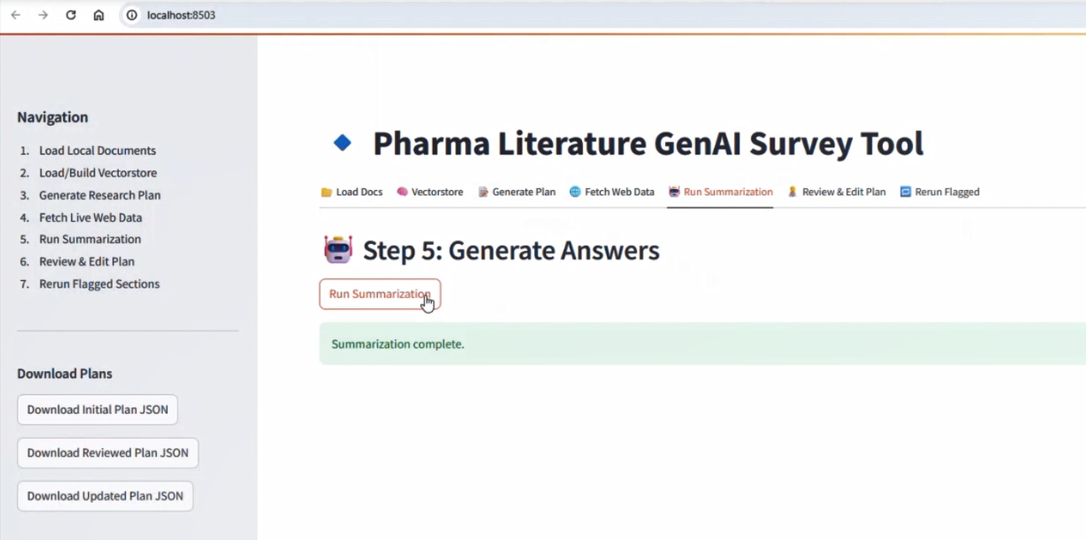
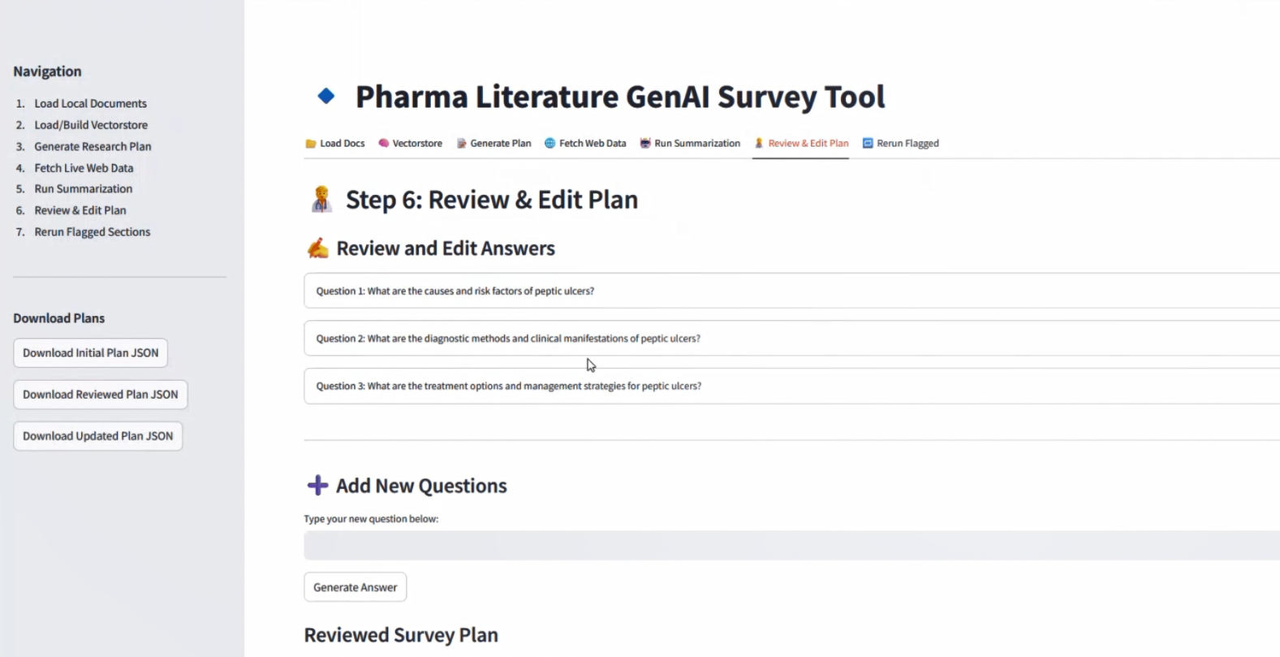

Slide 5
